Slide 1

LZL Engineering
DEVELOPING PROCESS & EQUIPMENT
SOLUTIONS FOR YOUR APPLICATIONS

Slide 2

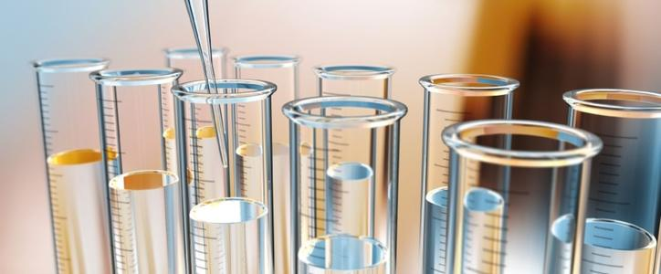
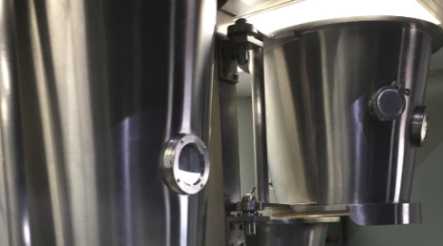
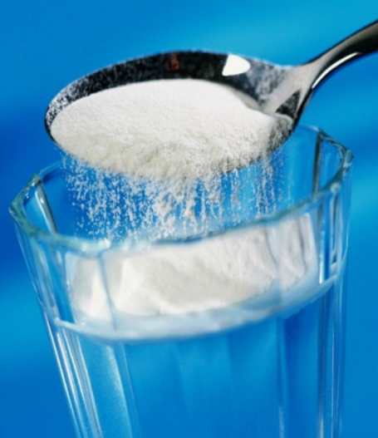
Company Profile
●
LZL Engineering is a professional technical support company, focusing on delivering innovative, cost-effective food ingredient and processing solutions
to keep customers ahead of trends.
Our founder and innovative engineer Laurence Lee (Ph.D./MBA) has 30 years of world-renowned experience in ingredient processing, particle coating and product formulating.
As a state-of-the art processing solution company, our technical service team brings real value to our clients. From toll processing, R&D support to equipment customization and installation, we provide the one-stop solution. A client can come to LZL Engineering with nothing more than an idea and come out with a proprietary process and a business-value product ready for market.
●
●

Slide 3
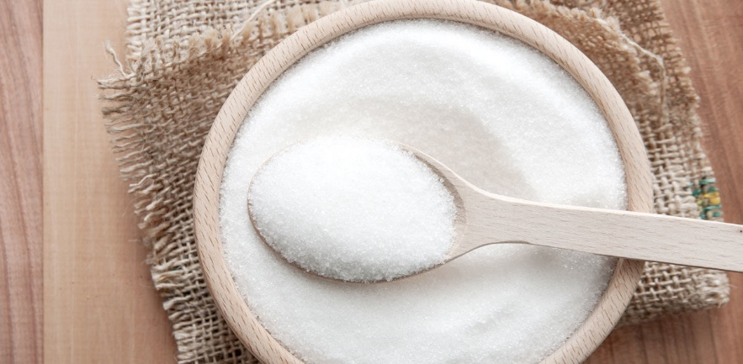

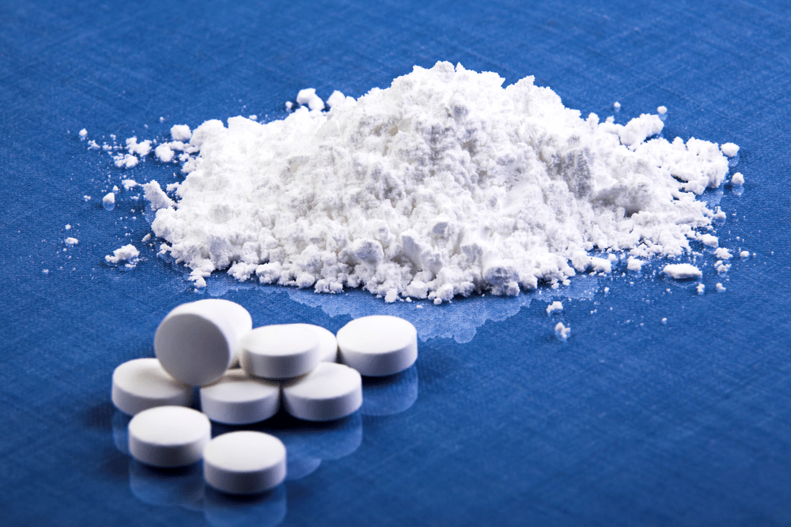
Our Services
Toll Manufacturing
●
Agglomeration / Instantizing
Encapsulation / Coating
●
Contract Research
●
Product Formulation
Laboratory Testing
Pilot Plant Test to Full Scale Commercialization
●
●
Equipment
●
Next Generation Agglomeration & Encapsulation Fluid Bed Systems
Facility Design Assistance
Equipment Installation Support
Technical Staff Training
Post Sale, Parts & Maintenance Support
●
●
●
●

Slide 4
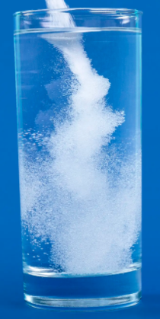
Agglomeration & Instantization
Advantages
Application Examples
Disperse and Dissolve Instantly
Fast Wetting
Improved Flowability
Target Density for Packaging
Particles Size & Structure Optimization
Less Dusty Powder
Whey Protein Isolate
Cocoa Drink
Collagen
Dried Egg White
Hydrocolloids
Sweeteners
Nutraceutical/Pharmaceutical Excipients
….
●
●
●
●
●
●
●
●
●
●
●
●
●
Agglomeration
Instantly Soluble

Slide 5
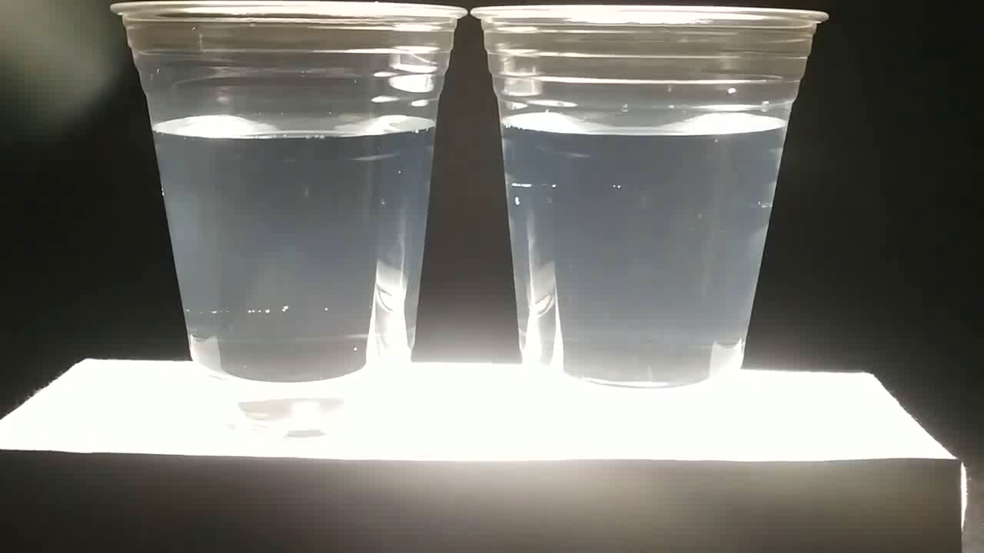
Agglomeration & Instantizing
Video: Agglomeration makes powders disperse and dissolve instantly when added to a liquid.
No Agglomeration
LZL Agglomeration

Slide 6
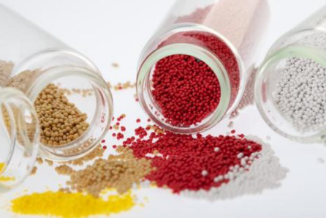
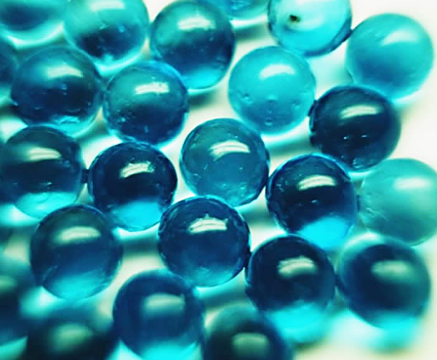
Encapsulation & Coating
Advantages
Application Examples
●
Control Release
Flavor/Odor Masking
Ingredient Protection Against Moisture,
Oxygen, Heat, and Light
Shelf-life Extension
Convert Liquid into Solid for Ease of
Handling and Transportation
Coloring
Food Acid
Vitamin
Flavor
Essential oil
Probiotic
Enzyme
Nutraceutical/Pharmaceutical
Active Ingredients …
●
●
●
●
●
●
●
●
●
●
●
●
Encapsulation
Core-Shell
Encapsulation
Matrix

Slide 7
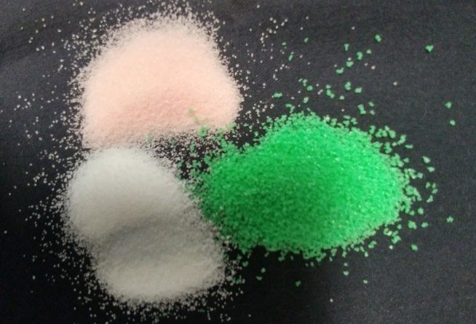

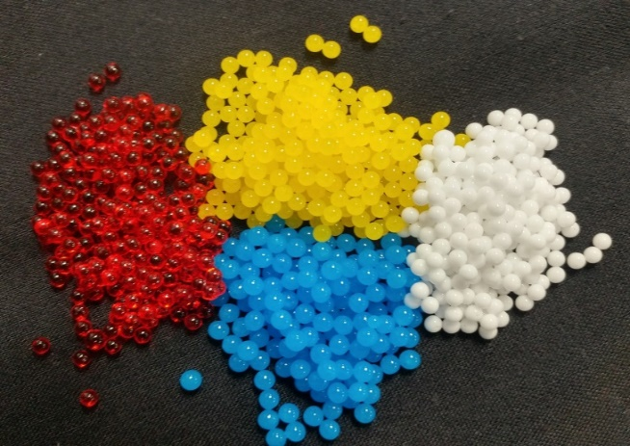
Encapsulation & Coating
LZL R&D Encapsulation Prototypes
Particle Coating
Core-Shell Monosphere
Produce Core-Shell Monospheres

Slide 8
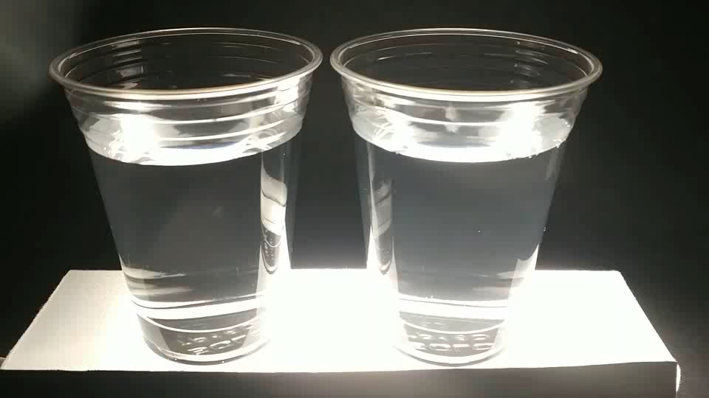
Encapsulation & Coating
Video: Encapsulation forms a coating layer on products and significantly changes their surface properties, e.g., from water soluble to water insoluble
No Encapsulation
LZL Encapsulation

Slide 9
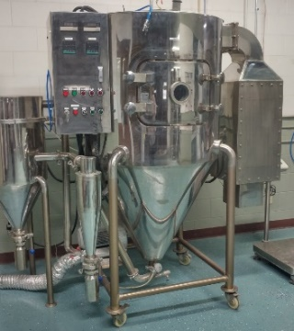
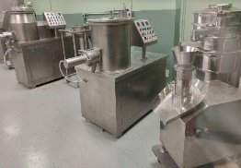
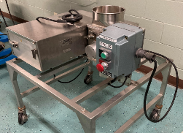
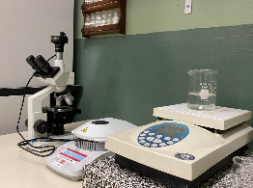
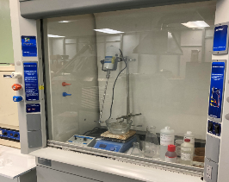
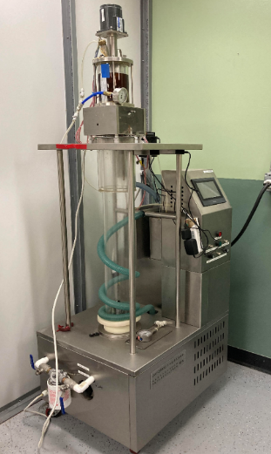
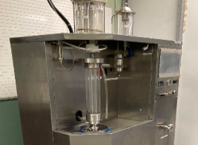
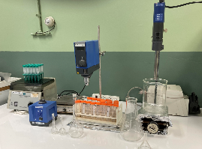
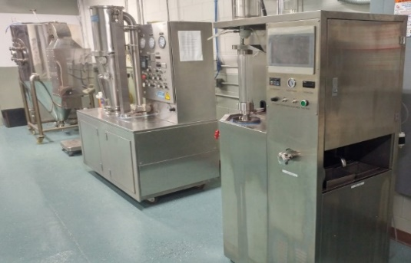
Contract Research
LZL assists clients with all particle process needs utilizing our full range of in-house pilot/lab equipment.
From development to product launch, we are here to provide varied support and solutions for your process challenges
●
Product Formulation
Fluid Bed Pilot Plant Test
Commercialization
Particles Physical Properties Testing
Surface Property Modification & Testing
Milling, Spray Drying, Prilling, Extrusion
Emulsification & Colloids Preparation
…
●
●
●
●
●
●

Slide 10
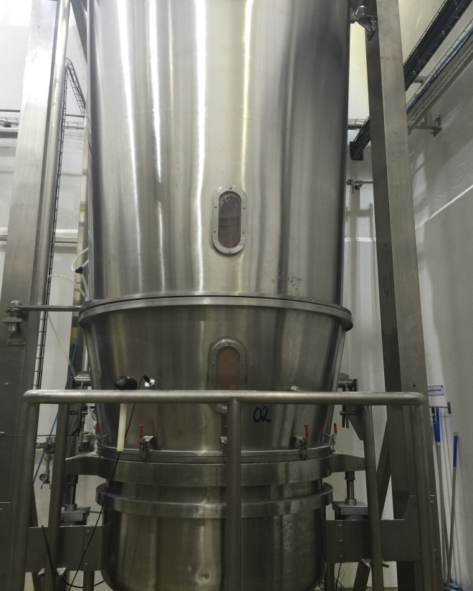
Next Generation multiple-use Fluid Bed Systems
LZL next generation Multiple-use Fluid Bed Systems are state-of-the-art and readily customizable for clients’ specific applications.
●
Equipment Options available on 5 / 30 / 120 / 300 / 500 kg Units
Precise process control for agglomeration and encapsulation applications
Lipid & Aqueous Coating
High shear granulation
Automated product load and unload
In-line sample taken for QC testing
Easy-to-use automated control systems
●
●
●
●
●
●
COMMERCIAL 300 KG
FLUID BED SYSTEM

Slide 11
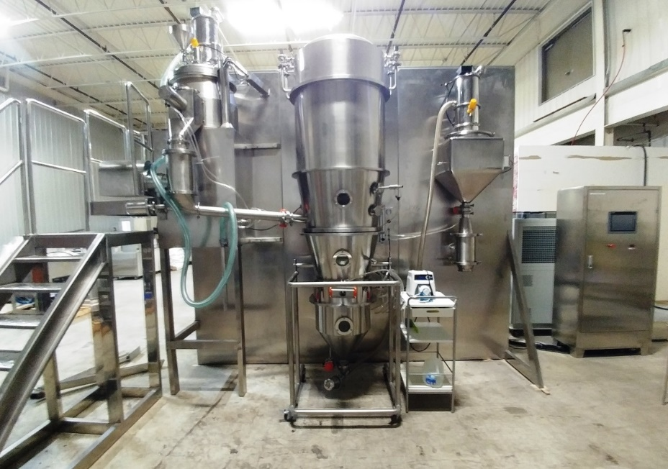
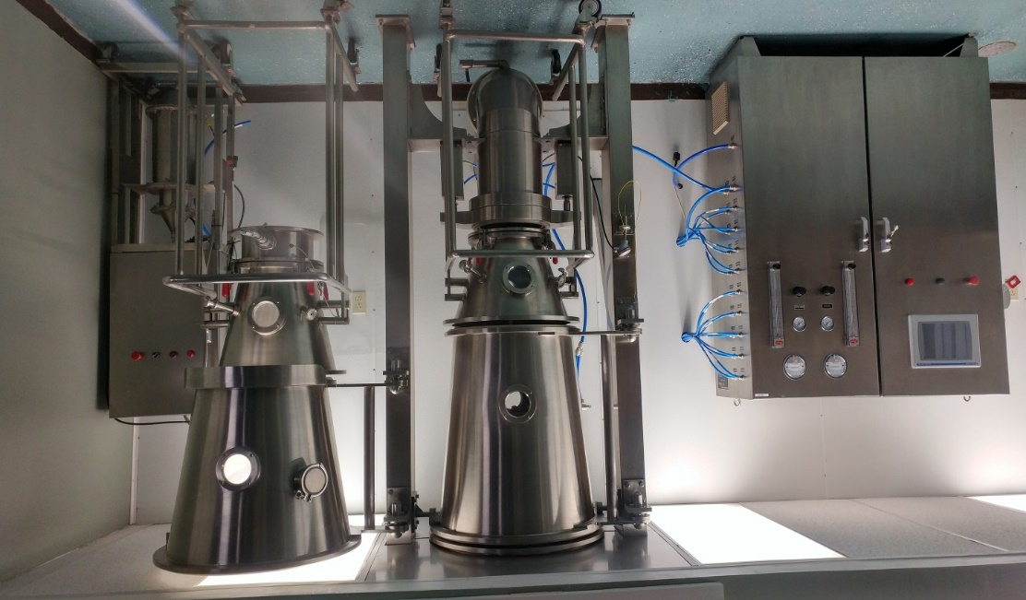
5 KG R&D Agglomeration & Encapsulation System
Next Generation multiple-use Fluid Bed Systems
30 KG AGGLOMERATION & ENCAPSULATION SYSTEMS

Slide 12


Next Generation multiple-use Fluid Bed Systems
Corporate Headquarters
Global Installations
LZL technologies support industrial applications on a global scale in
Animal Nutrition
Aquaculture
Biotechnology
Human Nutrition
Industrial Chemicals
Utilizing
Controlled Release
Particle Protection&
Particle Formation
Characteristics
to enhance client’s bottom line with our proprietary technology.
●
●
●
●
●

Slide 13

Our Commitment
.
●
LZL’s dedicated facility provides research labs, pilot plants and full-scale commercial systems for prototype and toll processing. From development to product launch, LZL provides varied support and solutions for your process challenges.
●
LZL’s innovative fluid bed technology and decades of industrial experience provides better agglomerated particle structure for superior dispersion and dissolution, and better particle coating in hot-melt and aqueous shell materials provide superior controlled release, controlled reactions and product protection.
●
New Generation LZL fluid bed systems are optimized for customized applications. Upgrade and automate your existing system for simpler process control and increased productivity. Efficient precision plating and wet cake drying are an added advantage.

Slide 14
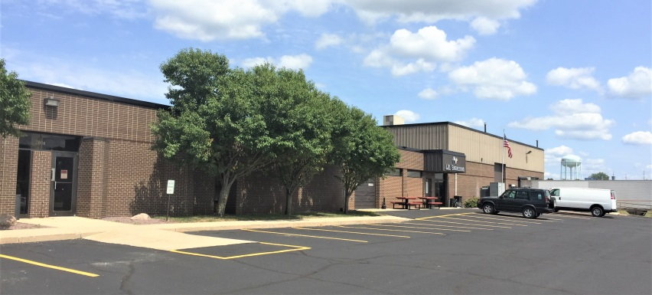
Contact
Tel: 612-930-7330
Email: info@lzlengineering .com
Laurence Lee, Ph.D./MBA, CEO
Email: laurence.lee@lzlengineering.com
Gary Masters, General Manager
Email: gary.masters@lzlengineering.com
Headquarters & Technical Center :
LZL Engineering, LLC
2300 Park Drive, Suite 300
Owatonna, MN 55060 USA
Melody Hanson, VP Sales & Marketing
Email: melody.hanson@lzlengineering.com

